Slide 1

Clustering Algorithms

Slide 2
Affinity Propagation Algorithm
Overview:
Affinity Propagation (AP) is a clustering algorithm that identifies exemplars (representative data points) from a dataset and assigns other points to these exemplars based on a similarity measure. Unlike traditional clustering algorithms like k-means, AP does not require the number of clusters to be predefined.
Instead, it takes a similarity matrix as input, where each entry represents the similarity between two data points, and iteratively refines the clusters through message passing between data points

Slide 3
Affinity Propagation Algorithm
Pros:
No Predefined Cluster Number: Automatically determines the number of clusters based on the data.
Flexibility in Similarity Measure: Works with any similarity metric, making it versatile for diverse datasets.
Handles Asymmetric Data: Can handle situations where similarities between points are not symmetric.
Exemplar-Based Clustering: Provides actual data points as cluster centers, which are easier to interpret than abstract centroids.
Efficient for Small Datasets: Works well for smaller datasets with meaningful similarity matrices.

Slide 4
Affinity Propagation Algorithm
Cons:
Sensitive to Parameters: The choice of the preference parameter (which influences the number of clusters) and damping factor significantly affects results.
Memory Usage: Requires storing a full similarity matrix in memory, making it impractical for very large datasets.
Convergence Issues: May not converge or can converge to suboptimal solutions depending on the initialization and parameter choices.
Similarity Matrix Requirement: Requires the user to define a meaningful similarity measure, which can be challenging for high-dimensional or unstructured data.

Slide 5

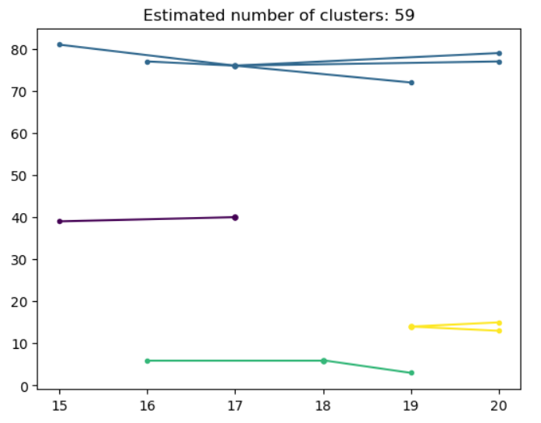
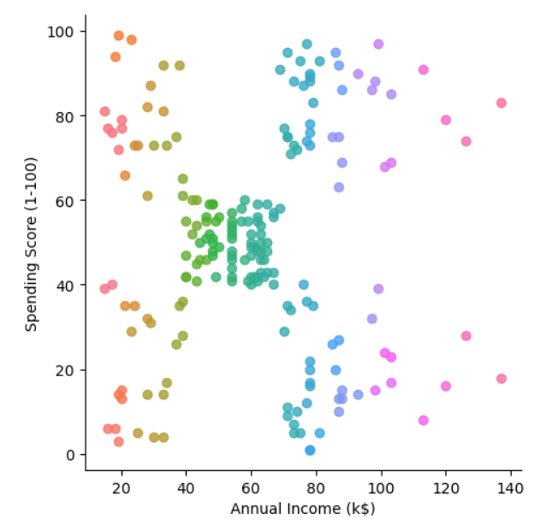
Affinity Propagation Algorithm

Slide 6
Mean-Shift Clustering
Overview:
The mean-shift algorithm is a non-parametric clustering technique often used in computer vision and pattern recognition. It works by iteratively shifting data points toward the mode (peak) of the density of points in a feature space, effectively identifying clusters based on the density of data points.

Slide 7
Mean-Shift Clustering
Pros:
Non-Parametric: It doesn't require predefining the number of clusters, unlike k-means.
Flexible Cluster Shapes: It can identify clusters of arbitrary shapes, as it relies on the density of points rather than geometric assumptions.
Robust to Noise: By focusing on high-density regions, the algorithm is less influenced by outliers.
Adaptable: The bandwidth parameter allows tuning for different densities in the dataset.
Applicable to Various Domains: It is widely used in applications like image segmentation, object tracking, and mode detection.

Slide 8
Mean-Shift Clustering
Cons:
Bandwidth Selection: Choosing the right bandwidth is critical and non-trivial, as it heavily influences the clustering results.
High Computational Cost: It can be computationally expensive, especially for large datasets, as each point requires kernel evaluation for every iteration.
Sensitive to Initialization: Poor initialization can lead to suboptimal clustering or longer convergence times.
Scalability Issues: Mean-shift struggles with very large datasets due to its iterative and density-based approach.
Cluster Merging: Nearby clusters might be merged if the bandwidth is too large, making it challenging to separate distinct groups.

Slide 9

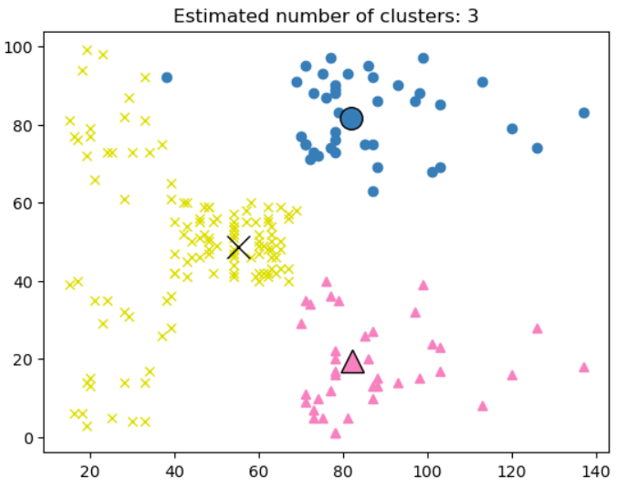
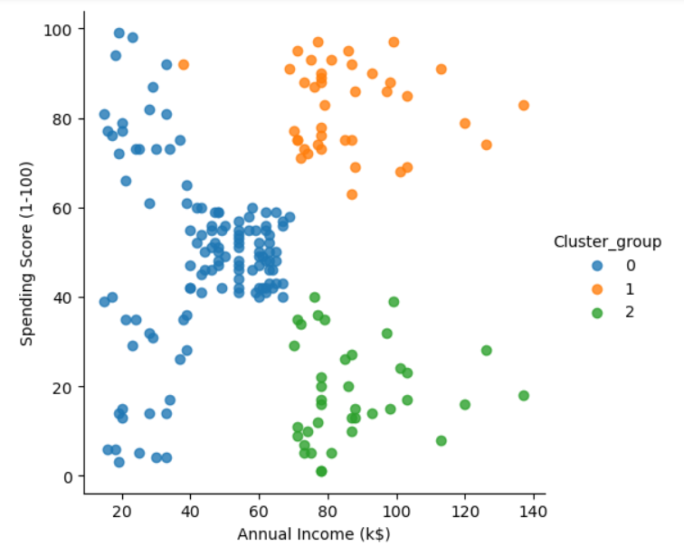
Mean-Shift Clustering

Slide 10
Agglomerative Clustering
Overview:
Agglomerative clustering is a hierarchical clustering method that builds clusters in a bottom-up approach. It starts with each data point as its own cluster and iteratively merges the closest clusters until all points are grouped into a single cluster (or until a predefined stopping condition is met). The result is represented as a dendrogram, a tree-like structure showing how clusters were merged at each step.

Slide 11
Agglomerative Clustering
Pros:
No Need to Predefine Cluster Numbers: Unlike k-means, it does not require the number of clusters to be specified upfront.
Handles Arbitrary Shapes: It can form clusters of arbitrary shapes and sizes, depending on the linkage criteria.
Produces a Dendrogram: The dendrogram provides a visual representation of the clustering process, allowing for exploration of cluster relationships and hierarchical structures.
Flexible Distance Metrics: It supports a variety of distance measures and linkage methods, making it adaptable to different datasets.
Works Well with Small Datasets: It performs well for datasets with fewer data points where interpretability is important.

Slide 12
Agglomerative Clustering
Cons:
Sensitive to Noise and Outliers: Outliers can significantly affect the clustering process, leading to misleading results.
Linkage Criteria Limitations: The choice of linkage method (single, complete, average, etc.) can drastically affect the clustering results, and the best method often depends on the dataset.
Difficulty in Large Dendrograms: Interpreting dendrograms can become challenging for large datasets with many points.
No Global Objective Function: Unlike k-means or other clustering algorithms, it doesn’t optimize a specific objective function, which can lead to inconsistencies.

Slide 13

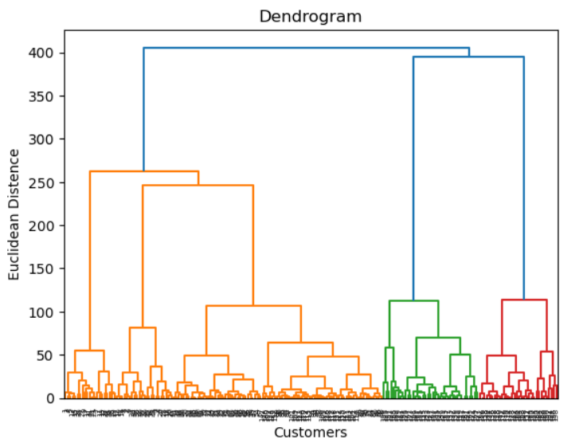
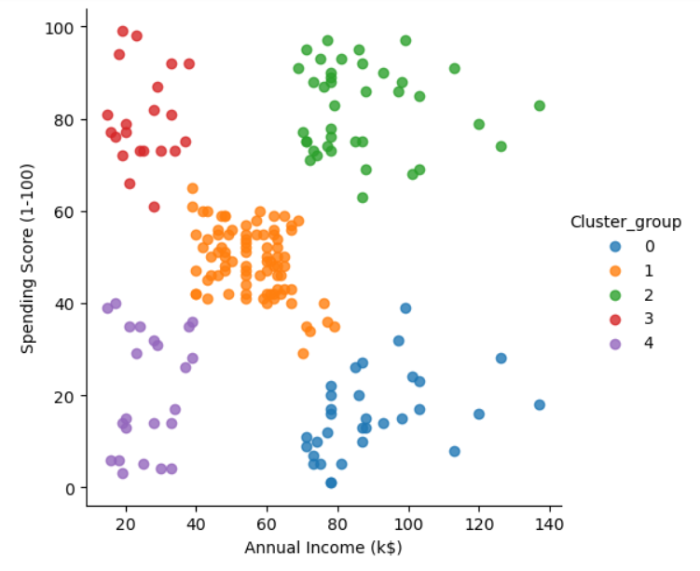
Agglomerative Clustering

Slide 14
K-Means Clustering
Overview:
The k-means algorithm is a popular partition-based clustering technique used to divide a dataset into kkk clusters. It minimizes the variance within each cluster by iteratively refining cluster assignments and cluster centers.

Slide 15
K-Means Clustering
Pros:
Simplicity: The algorithm is straightforward and easy to implement.
Speed: It converges relatively quickly, making it suitable for large datasets.
Clear Objective Function: It minimizes the within-cluster sum of squares (WCSS), providing a clear optimization goal.
Widely Applicable: K-means is used in various domains like image segmentation, customer segmentation, and recommendation systems.

Slide 16
K-Means Clustering
Cons:
Predefined Number of Clusters: The number of clusters must be specified in advance, which can be challenging without prior knowledge.
Sensitive to Initialization: Poor initialization of centroids can lead to suboptimal clustering. Techniques like k-means++ can mitigate this.
Assumes Spherical Clusters: K-means assumes clusters are spherical and of similar size, making it unsuitable for datasets with irregular or varying-sized clusters.
Sensitive to Outliers: Outliers can distort cluster centroids and lead to poor clustering results.
Convergence to Local Optima: The algorithm may converge to a local minimum, depending on the initial centroids.
Works Best with Numerical Data: It struggles with categorical data unless additional preprocessing is applied.

Slide 17
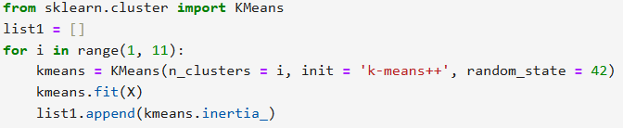
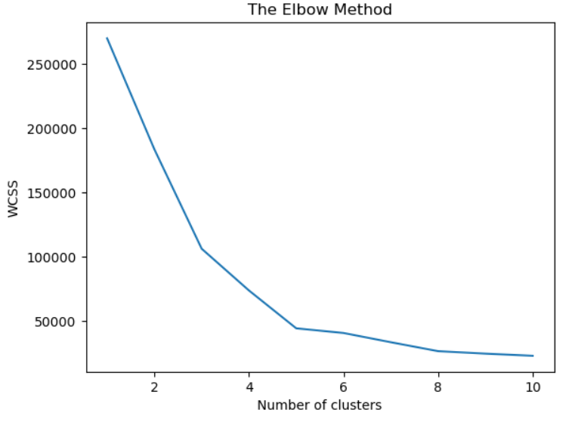
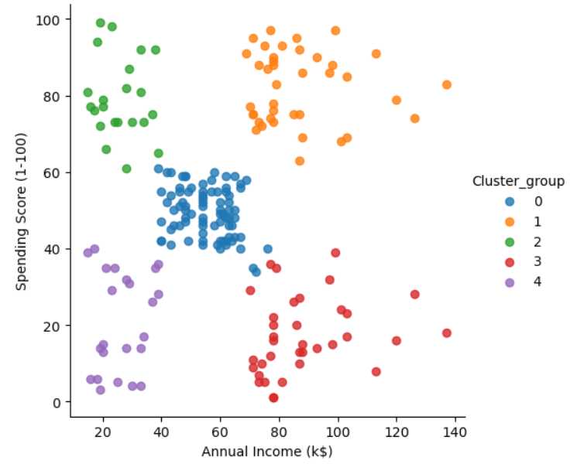
K-Means Clustering

Slide 18
Spectral Clustering
Overview:
Spectral clustering is a graph-based clustering technique that uses the eigenvalues of a similarity matrix (or its graph Laplacian) to reduce dimensionality before applying a traditional clustering method like k-means. It is particularly effective for identifying clusters that are not linearly separable or have complex structures.

Slide 19
Spectral Clustering
Pros:
Handles Non-Linear Boundaries: It can identify clusters of arbitrary shapes and sizes, making it suitable for complex datasets.
Works Well on Graphs: Spectral clustering is naturally suited for graph-based data, such as social networks or molecular structures.
Dimensionality Reduction: By working in the reduced-dimensional space of eigenvectors, it avoids high-dimensional challenges.
Flexibility: The similarity matrix can be customized for specific problems, allowing the algorithm to adapt to various datasets.
Effective for Sparse Clusters: It excels at finding clusters in datasets where the cluster density varies significantly.

Slide 20
Spectral Clustering
Cons:
Requires Similarity Matrix: Constructing the similarity matrix can be computationally expensive and memory-intensive for large datasets.
Choice of Parameters: The algorithm depends on hyperparameters like the similarity metric, graph construction method, and the number of clusters.
Lack of Interpretability: The eigenvectors and graph Laplacian are mathematical constructs that can be hard to interpret in real-world terms.
Sensitive to Noise: Noisy or sparse datasets can produce unreliable similarity matrices, leading to poor clustering results.

Slide 21

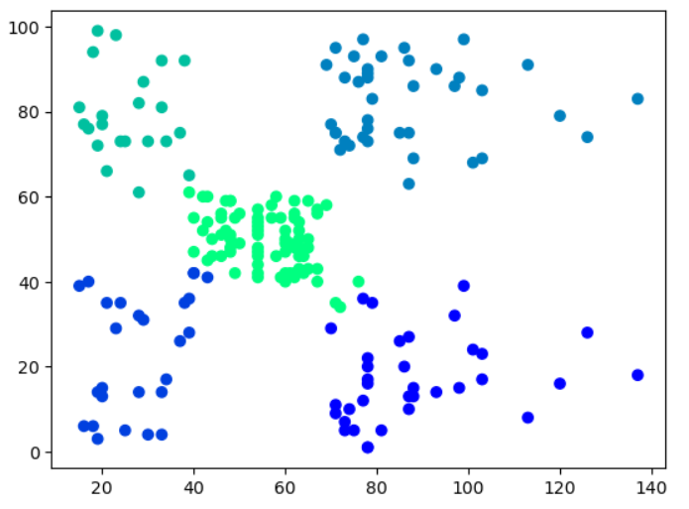
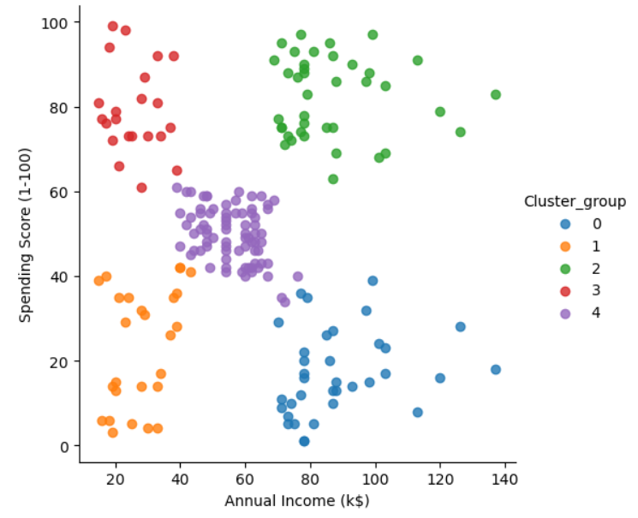
Spectral Clustering

Slide 22
DBSCAN (Density-Based Spatial Clustering of Applications with Noise)
Overview:
DBSCAN is a density-based clustering algorithm that groups points based on the density of their neighborhood. It identifies clusters as dense regions separated by areas of lower density and can classify points as core points, border points, or noise

Slide 23
DBSCAN (Density-Based Spatial Clustering of Applications with Noise)
Pros:
No Need to Predefine Number of Clusters: Unlike k-means, DBSCAN automatically determines the number of clusters.
Identifies Arbitrary-Shaped Clusters: It is effective at discovering clusters of varying shapes, even when they are not linearly separable.
Robust to Noise and Outliers: It can identify noise points and exclude them from clusters.
Scales Well for Low-Dimensional Data: DBSCAN is efficient for datasets with lower dimensions and can handle moderate-sized datasets.
Works Well with Varying Cluster Sizes: It does not assume clusters are of equal size or density.

Slide 24
DBSCAN (Density-Based Spatial Clustering of Applications with Noise)
Cons:
Not Scalable for High Dimensions: The distance computation becomes expensive in high-dimensional spaces, and performance degrades.
Struggles with Varying Densities: It assumes clusters have similar densities, so it may fail if the dataset contains clusters with varying densities.
Limited for Large Datasets: DBSCAN can be slow for very large datasets due to the need to compute distances between all points.
Hard to Interpret Noise Points: While DBSCAN identifies noise points, their interpretation in real-world contexts can be unclear.

Slide 25

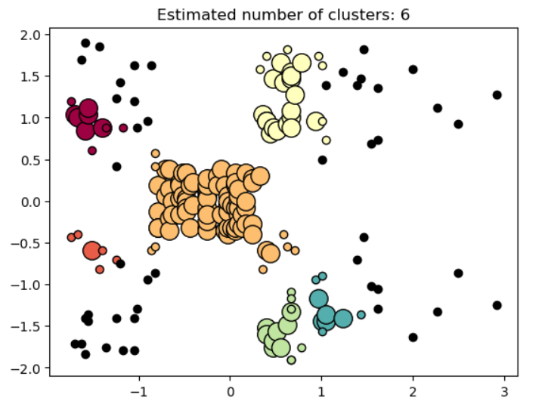
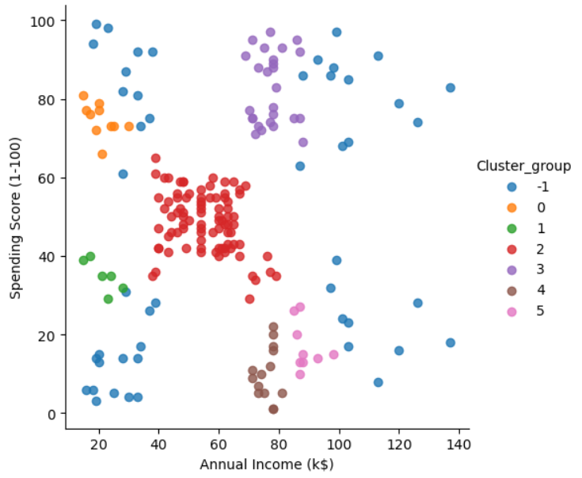
DBSCAN (Density-Based Spatial Clustering of Applications with Noise)

Slide 26
HDBSCAN (Hierarchical Density-Based Spatial Clustering of Applications with Noise)
Overview:
HDBSCAN is an extension of the DBSCAN algorithm that improves its ability to identify clusters of varying densities. It builds a hierarchical clustering structure based on the density of data points and then extracts stable clusters from this hierarchy. Unlike DBSCAN, HDBSCAN doesn’t require a fixed density threshold and automatically determines the number of clusters.

Slide 27
HDBSCAN (Hierarchical Density-Based Spatial Clustering of Applications with Noise)
Pros:
No Need to Predefine Clusters: It automatically determines the number of clusters, unlike k-means or DBSCAN.
Handles Varying Densities: HDBSCAN is robust to clusters with different densities, unlike DBSCAN.
More Robust Noise Detection: It provides better handling of outliers and noise points.
Produces a Hierarchy: The dendrogram can reveal relationships between clusters at various levels of granularity.
Scalable for Large Datasets: With efficient implementations, HDBSCAN can handle larger datasets compared to DBSCAN.
Customizable Output: HDBSCAN offers both flat clustering (a single set of clusters) and hierarchical clustering for deeper analysis.

Slide 28
HDBSCAN (Hierarchical Density-Based Spatial Clustering of Applications with Noise)
Cons:
Complex Parameter Selection: Requires setting parameters like min_cluster_size (minimum size for a cluster) and min_samples (density threshold).
Computationally Intensive: While more scalable than DBSCAN, it can still be slower for extremely large datasets.
High Dimensionality Issues: Similar to DBSCAN, HDBSCAN struggles in high-dimensional spaces due to the curse of dimensionality affecting distance calculations.
Interpretation Challenges:The dendrogram can be complex to interpret, and users may need domain knowledge to make sense of hierarchical structures.
Sensitive to Noisy Data:
While better than DBSCAN at handling noise, its performance can still degrade if the dataset is overly noisy or sparse.

Slide 29

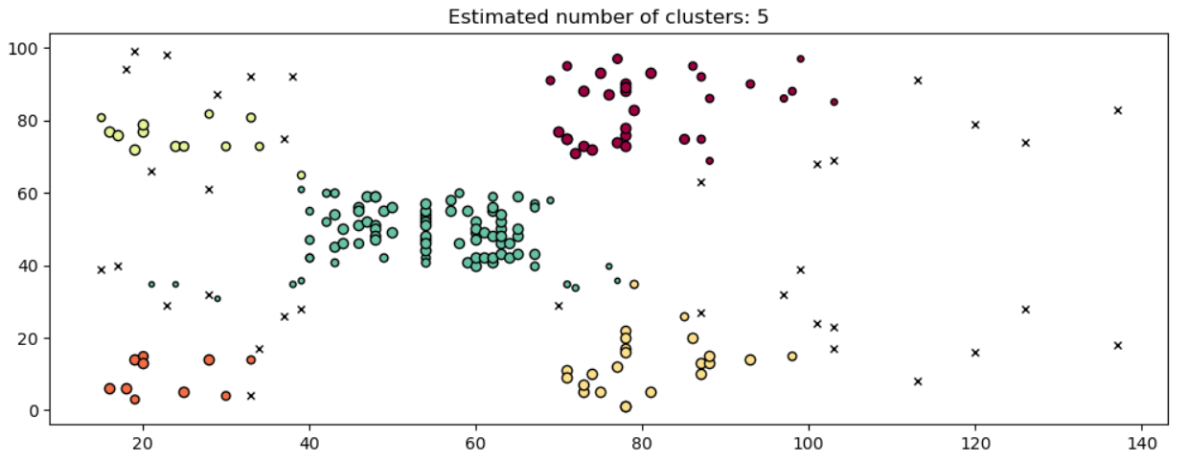
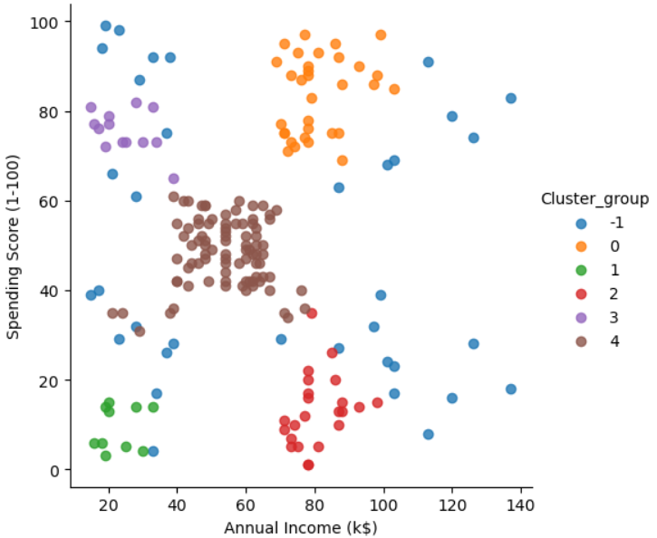
HDBSCAN (Hierarchical Density-Based Spatial Clustering of Applications with Noise)

Slide 30
OPTIC
Overview:
OPTICS (Ordering Points To Identify the Clustering Structure) is a density-based clustering algorithm. It is an extension of DBSCAN (Density-Based Spatial Clustering of Applications with Noise) that overcomes DBSCAN's limitation of requiring a fixed density threshold. OPTICS generates a reachability plot, which captures the hierarchical clustering structure based on varying density levels.
The algorithm processes data points to form clusters by analyzing their density connectivity. Instead of explicitly assigning points to clusters, it maintains an ordering of the data points that reveals the clustering structure at different density levels.

Slide 31
OPTIC
Pros:
Handles Varying Densities: Unlike DBSCAN, OPTICS can detect clusters of varying density by analyzing the reachability plot.
Noise Handling: Like DBSCAN, it can identify and exclude noise from clusters.
No Fixed Density Threshold: OPTICS does not require the user to specify a single global density threshold.
Hierarchical Clustering: Provides a hierarchical view of clusters, making it easier to visualize and explore data.
Scalability: Efficient for large datasets compared to traditional clustering algorithms.

Slide 32
OPTIC
Cons:
Complex Interpretation: Analyzing the reachability plot can be subjective and challenging.
High Complexity: Higher computational complexity compared to DBSCAN due to maintaining additional structures for reachability distances.
Cluster Shape Dependence: Struggles with non-convex cluster shapes if the reachability plot does not clearly distinguish clusters.
Visualization Dependency: Requires manual inspection of the reachability plot for optimal cluster identification.

Slide 33

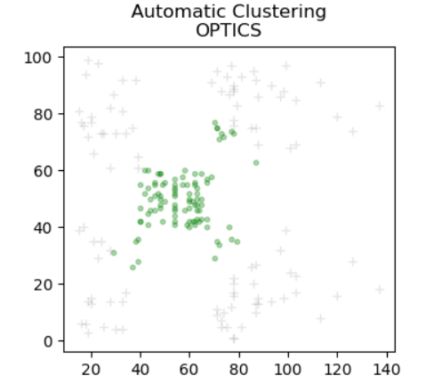
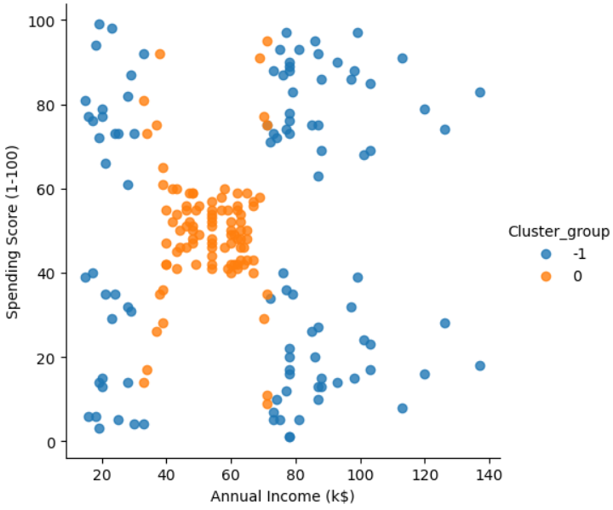
OPTIC

Slide 34
BIRCH
Overview:
BIRCH (Balanced Iterative Reducing and Clustering using Hierarchies) is a hierarchical and scalable clustering algorithm designed for large datasets. It incrementally builds a hierarchical clustering structure called a Clustering Feature Tree (CF Tree) while scanning the data. The CF Tree is a height-balanced tree structure that summarizes the data points into compact representations, reducing memory and computational complexity.

Slide 35
BIRCH
Pros:
Scalability: Efficient for large datasets because it builds a compact representation incrementally.
Memory Efficiency: Stores only summary statistics rather than all data points.
Speed: Fast due to the single pass required to build the CF Tree.
Hierarchical Clustering: Can adapt to dynamic data with incremental clustering.
Noise Handling: Capable of handling noise by not merging points that are too far from clusters.

Slide 36
BIRCH
Cons:
Parameter Sensitivity: Performance depends on the branching factor and the threshold parameter.
Shape Limitation: Works best for convex-shaped clusters; struggles with more complex cluster shapes.
Memory Limitation for CF Tree: Limited by the size of the CF Tree in memory; requires careful parameter tuning to avoid tree overflow.
Dependency on Initial Threshold: Poor choice of threshold can lead to poor clustering results.

Slide 37

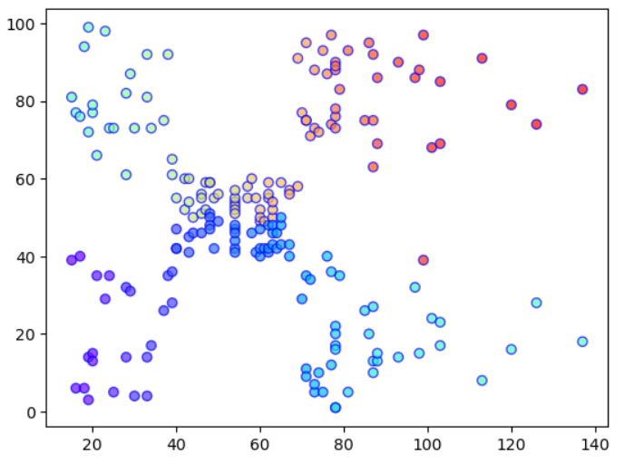
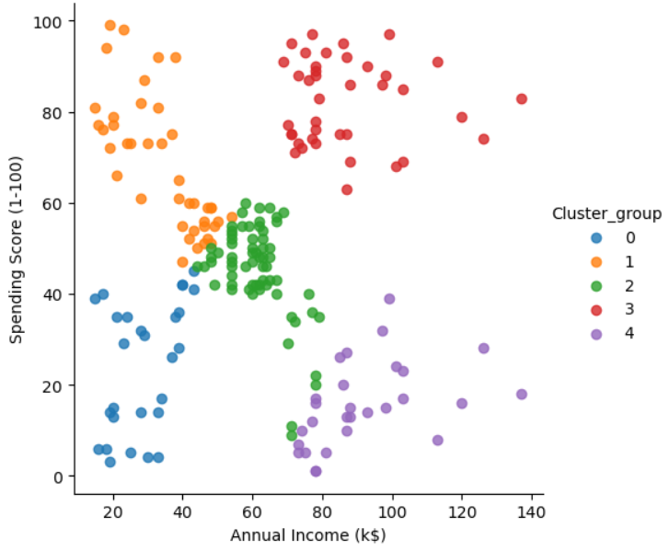
BIRCH

